Slide 1
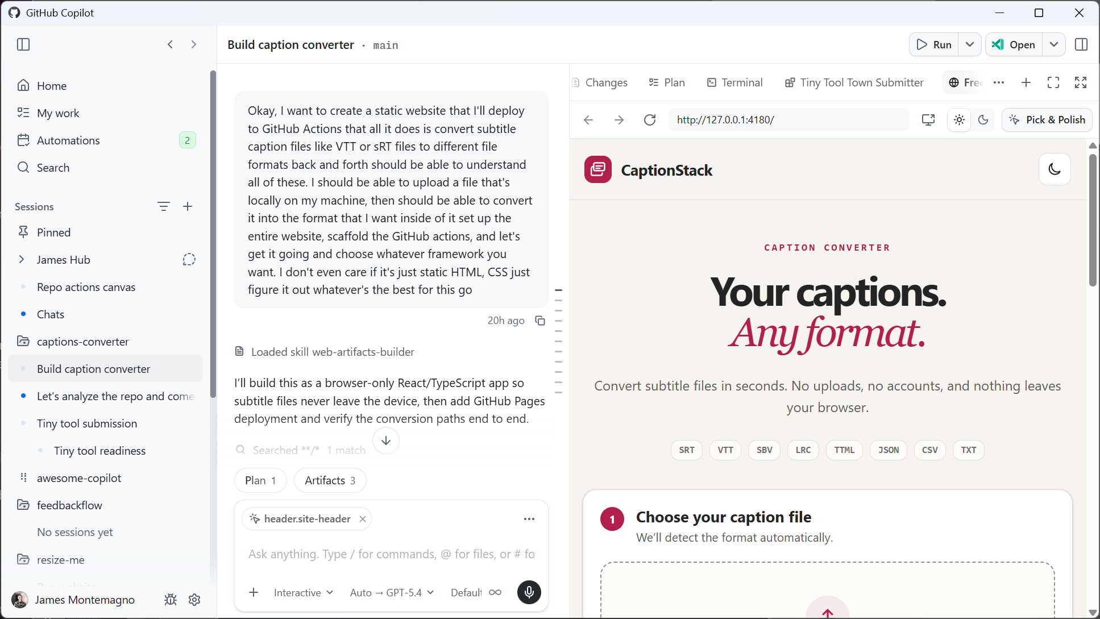
Github Dev Days
Agentic Software Development with GitHub Copilot App

Slide 2
Agenda
01 The Starting Problem & Core Idea
02 Anatomy of .github/
03 Foundational Mechanics
Why AI fails and how onboarding AI like a senior engineer fixes it
View all available models and choose which to use
Change working directory mid-session
04 Custom Agents & Security
05 Memory & Handoffs
06 Real-World Workflows
Plan out an implementation before writing any code
Manage your MCP servers
Fork the current session into a new session
07 Results & Impact
08 Key Takeaways
Schedule a prompt or skill within the current CLI session
Enable all permissions

Slide 3
The Ceiling LLMs Hit Immediately
Zero persistent memory: Forgets codebase context between sessions and repeats previously corrected mistakes.
Ignores team conventions: Produces syntactically valid code that violates repository naming, structure, and error patterns.
Blind to unwritten architecture: Misses hidden rules, state machines, and institutional knowledge stored in senior engineers' heads.
All-or-nothing trust trap: Developers either grant full unchecked authority or refuse to trust it with real work.

Slide 4
The Real Problem Isn’t the Model
        Re-Correcting AI Output
          Time spent fixing code that looked right but ignored your project's constraints.
        Prompt Libraries That Don't Scale
          Effective prompts stay with the person who wrote them instead of reaching the team.
        All-or-Nothing Trust
        Either it gets full access to the codebase, or none at all. Most teams default to none until its all.
        The bottleneck was never the model. It was missing context and missing guardrails.

Slide 5
Treat AI Onboarding Exactly Like Senior Engineer Onboarding

Slide 6
Treat AI Onboarding Exactly Like Senior Engineer Onboarding
          When you onboard a senior engineer, you hand them architecture docs, a style guide, a set of runbooks, and clear boundaries on what they're allowed to touch.
          Why treat an AI assistant any differently?
          Every Copilot customization in .github/ maps directly to a human onboarding artifact, written down in Markdown and versioned in Git.
        System & Architecture Doc
        Hand them a short summary of the stack and a list of things never to do → .github/copilot-instructions.md
        Team Style Guide
        Write down the conventions a code review would reject if broken → .github/instructions/
        Skill Library
        Give them step-by-step guides that only come out when the task calls for them → .github/skills/
        Task Boundaries
        Assign a specific task, with clear limits on what they can do → .github/agents/

Slide 7
Copilot Lives in the Repository, Not in Private Prompts
One configuration, every surface: The same .github/ files steer Copilot in VS Code agent mode, Copilot CLI in the terminal, the cloud agent on GitHub.com, and Copilot code review.
Version-controlled configuration: Instructions, skills and agents live in the repository and are checked into Git.
Shared team memory: Team conventions are written down once, reviewed in PRs, and enforced across every developer's machine.
Zero private prompt drift: Eliminates dependence on individual prompt histories or unshared local setups.
Notes:
The "one configuration, every surface" point is GitHub's strongest story for this audience — write the rules once and they apply whether a developer works in the IDE, the terminal, or assigns an issue to Copilot on GitHub.com.

Slide 8

Anatomy of .github/
Mechanism | Location | Who Writes | When Loaded | Onboarding Analogy
Repository instructions | .github/copilot-instructions.md / AGENTS.md | Humans | Every request | Day-one orientation doc
Path-specific instructions | .github/instructions/*.instructions.md | Humans | Always (applyTo: “**”) / on file match | Style guide & QA criteria
Agent skills | .github/skills/<name>/SKILL.md | Humans | Selected explicitly or delegated as subagent | Specialist coworker
Prompt files | .github/prompts/*.prompt.md | Humans | Invoked manually (/name) | Checklist on the wall
Hooks & permissions | .github/hooks/*.json, agent tools, CLI allow/deny rules | Humans | Enforced on every tool call | Physical access card
Copilot Memory | Github-hosted, repository-scoped | Copilot | Retrieved at session start | New hire’s private notebook

Slide 9
copilot-instructions.md Establishes Day-One Context and Boundaries
States the real constraints of the legacy framework directly, instead of letting the AI assume a modern default that won't work here.
Spells out the exact, non-standard build and test commands, so the AI never has to guess and fail silently.
Includes one table mapping each type of task to the rule or skill that applies, so nothing is left to chance.
Lists the things the AI must never do, stated plainly and without exception.
Defines a clear order for resolving conflicting instructions, so two rules can't quietly contradict each other.
        The idea is the same as onboarding a new colleague. The difference is this document gets read in full, every single time.

Slide 10
instructions/ Convert One-Time Corrections into Standing Policy
          Instead of one bloated file that gets ignored, we break instructions into focused *.instructions.md files.
          Each file declares where it applies with an applyTo glob with patterns like "**" for always-on rules, "src/Plugins/**/*.cs" for layer-specific ones.
          When a developer fixes a mistake once, we add an instruction so that mistake never happens again across the team.
        Code Style & Editing Discipline
        Follow code conventions, keep edits focused, and preserve unrelated work.
        Testing & Error Handling
        Describes testing expectations, validation steps, and error-handling standards.
        Project Context & Architecture
        Explains project structure, technologies, and architectural patterns.
        Security & Development Workflows
        Outlines security requirements and practices for building and delivering changes.

Slide 11
skills/ Scale Deep Expertise Without Context Bloat
Progressive Disclosure: Makes skill names and descriptions available first, loading detailed guidance as needed.
Reusable Workflows: Defines repeatable, step-by-step procedures for completing specific types of tasks.
Specialized Knowledge: Captures domain expertise and task-specific practices to guide Copilot’s work.
Bundled Resources: Packages instructions, scripts, templates, and references in a reusable skill folder.
        Instructions set the rules for working in your project; skills provide playbooks for particular tasks.

Slide 12
agents/ Delegate to Specialist Custom Agents with Narrow Authority
          Instead of one generalist agent doing an entire ticket in one unscoped session, the work is split across specialist custom agents
          Each one is an .agent.md profile with its own instructions, its own preferred skills, and a fixed tools list. In VS Code and Copilot CLI they can also run as subagents in their own isolated context.
        Technical-Design Agent
        Reads the issue, checks the existing codebase for what already exists, and writes the design document. It cannot edit source code at all.
        Code Implementation Agents
        Each one builds only its own layer of the code, follows the mandatory test-first instruction, and flags any work outside its layer instead of attempting it.
        Test-Writing Agent
        Writes tests only. If it finds a real bug along the way, it reports the finding instead of fixing production code itself.
        Review & Remediation Agents
        Read pull requests and code-quality findings, but cannot post a comment, edit a file or apply a fix without a human approving it first.

Slide 13
Trust Requires Hard Boundaries and Separated Roles
          This is the most crucial slide for trusting AI in real engineering teams.
          We don't rely on prompt goodwill.
          We enforce least privilege at the tool level and separate duties, so no single agent has unchecked power to plan, execute and approve its own work.
        Least Privilege by Design
        Limit each agent’s tools and underlying permissions to what its role requires.
        Separation of Duties
        Separate planning, execution, and approval to prevent unchecked agent authority.
        Hooks & Policy Enforcement
        Run automated checks at workflow events and block disallowed tool calls before execution.
        Human Review & Approva
        Require human approval for sensitive actions and enforce review gates before merging changes.

Slide 14
Machine-Enforced Guardrails Back Up Policy
Hooks & Automated Checks: Run checks at workflow events and deny tool calls that violate defined policies.
Tool & Integration Permissions: Restrict tools and external connections to the minimum access each agent needs.
Network & Secret Controls: Limit network access and expose only the credentials required for the task.
Guardrail Change Protection: Require designated reviewers to approve changes to agent configurations and security controls.

Slide 15
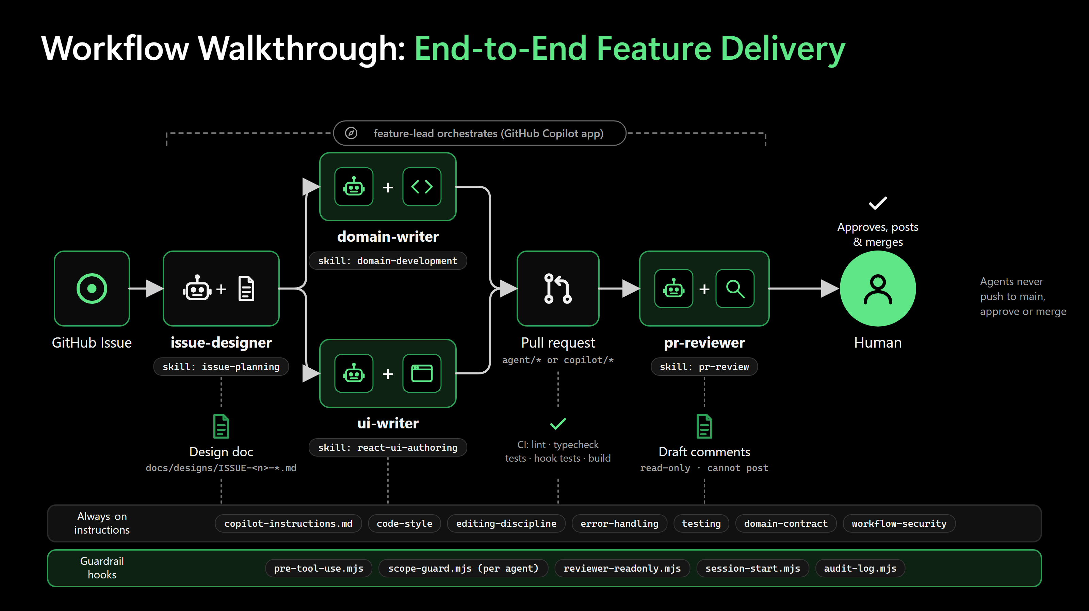

Slide 16
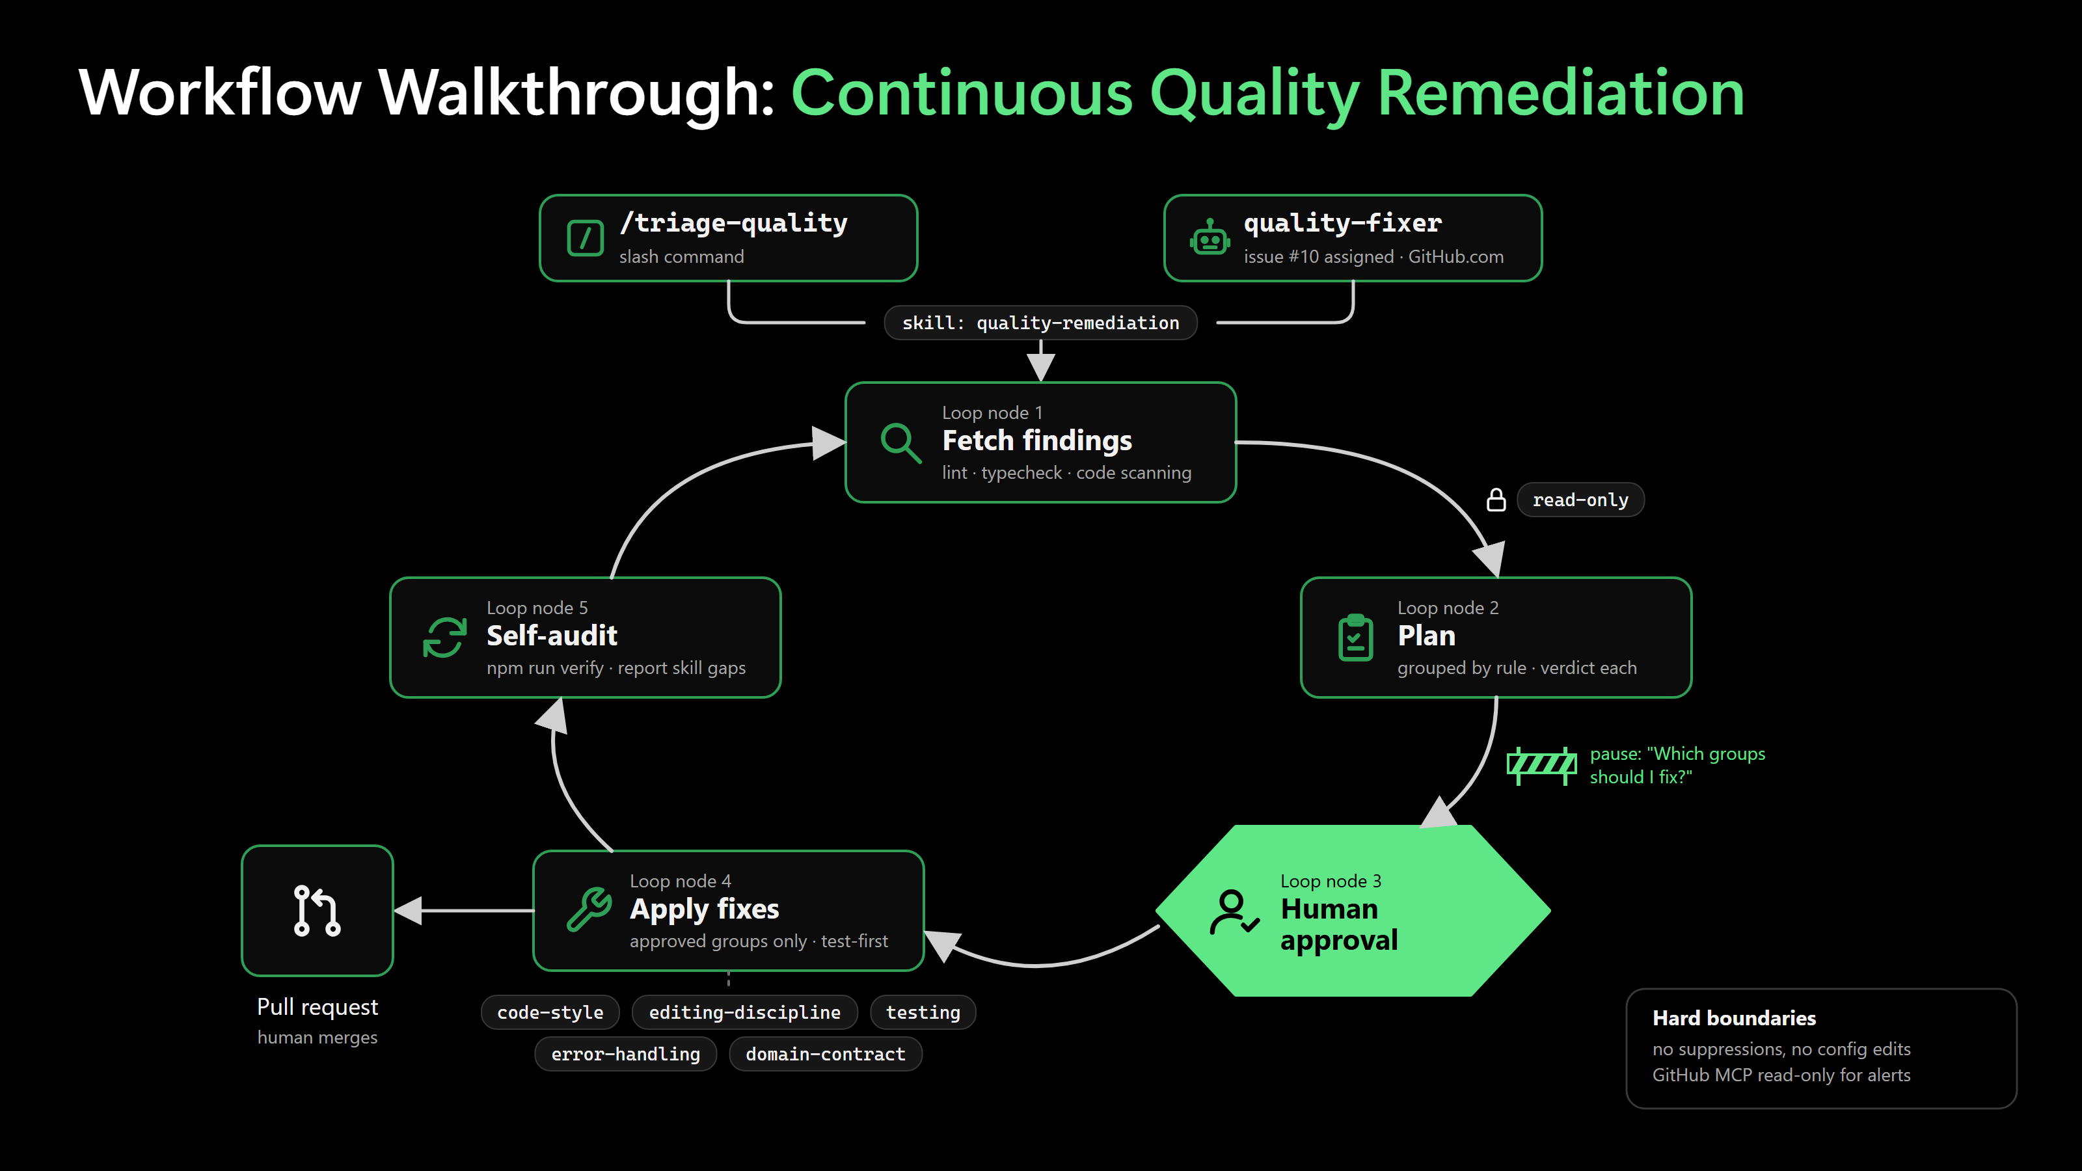

Slide 17
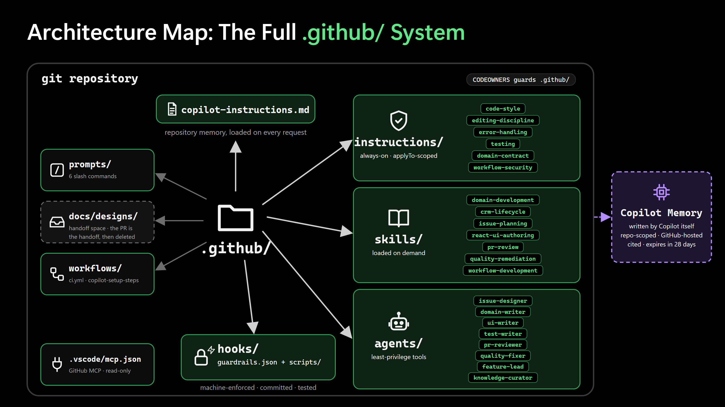

Slide 18
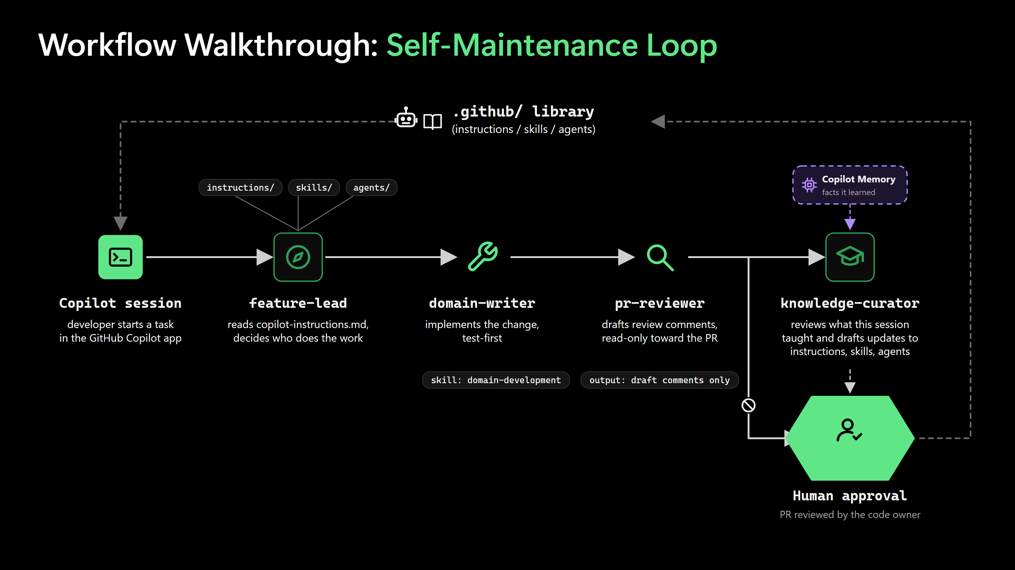

Slide 19
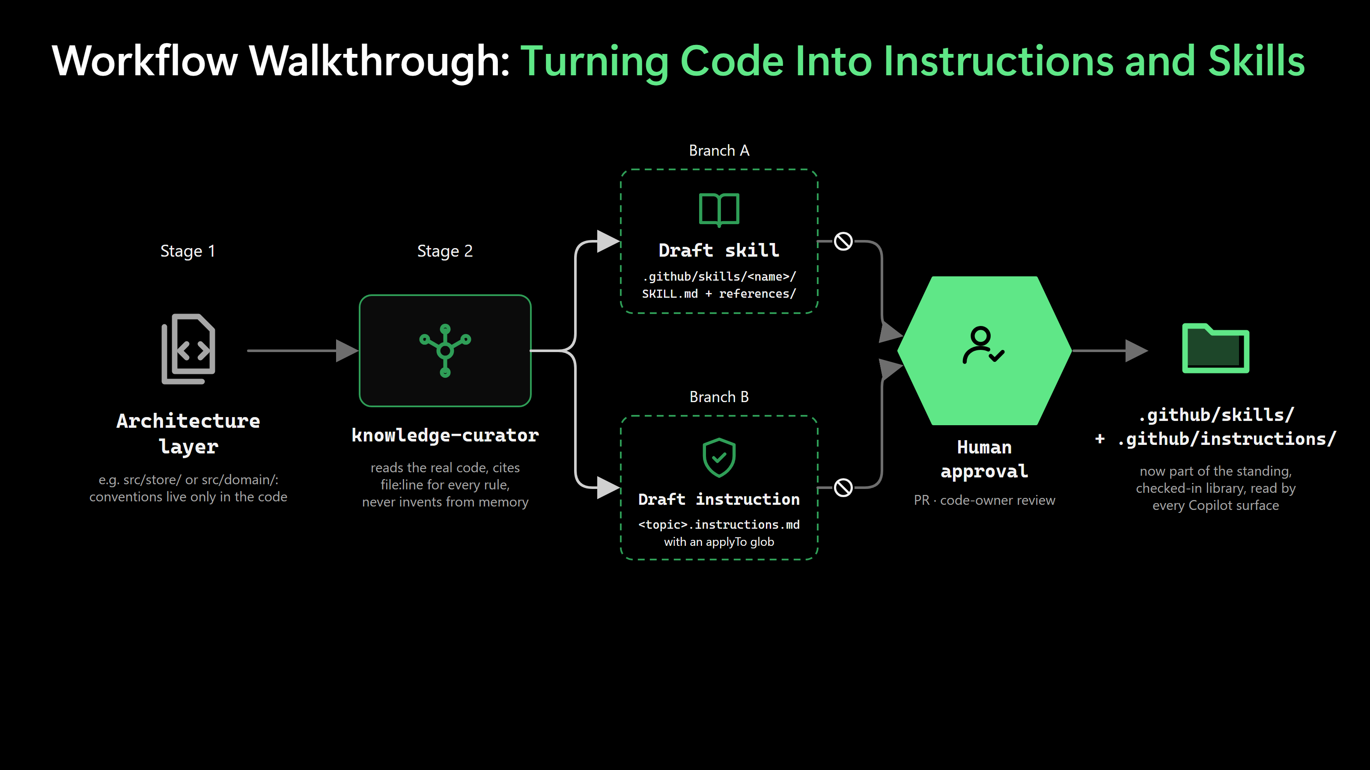

Slide 20
Measured Impact on a 5-Story-Point PB
Task | Before Setup | With .claude/ Setup
Writing unit tests for a ticket | 3-4 hours | ~30 minutes
Resolving critical code-quality finding | 6-8 hours | 30-45 minutes
Writing technical design for a ticket | ~1 hour | ~20 minutes
Reviewing one pull request | 25-30 minutes | ~10 minutes
Implementing well-scoped medium ticket | ~2 days | 3-4 hours

Slide 21
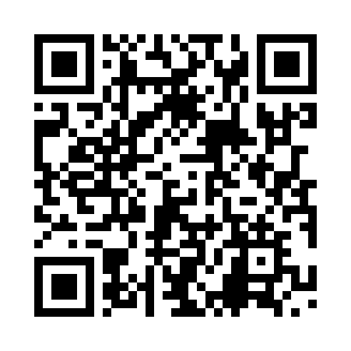
Thank you
Furkan Karacan Microsoft MVP
Adesso Turkey

